Slide 1
ASSIGNMENT 3
ANSWER KEY AND COMMON ERRORS

Slide 2
Question 1
Out of 12

Slide 3
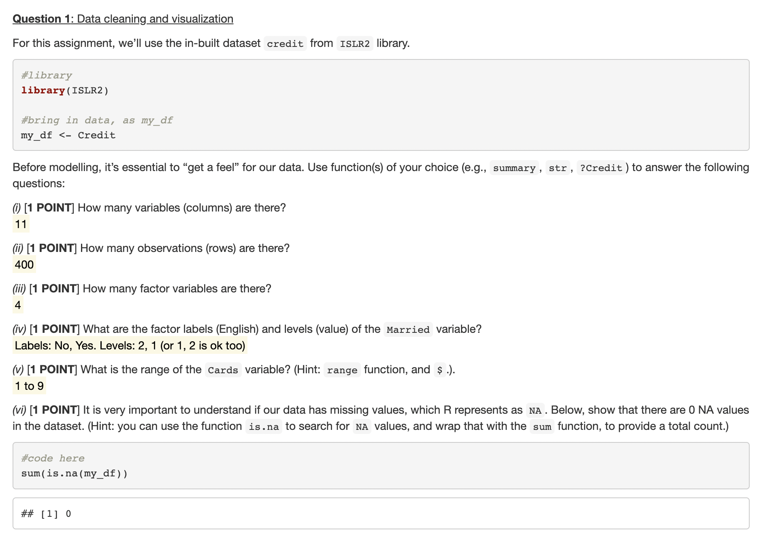
> dim(my_df)
[1] 400 11
> sum(sapply(my_df, is.factor))
[1] 4
> str(my_df$Married)
Factor w/ 2 levels "No","Yes": 2 2 1 1 2 1 1 1 1 2 ...
> range(my_df$Cards)
[1] 1 9

Slide 4
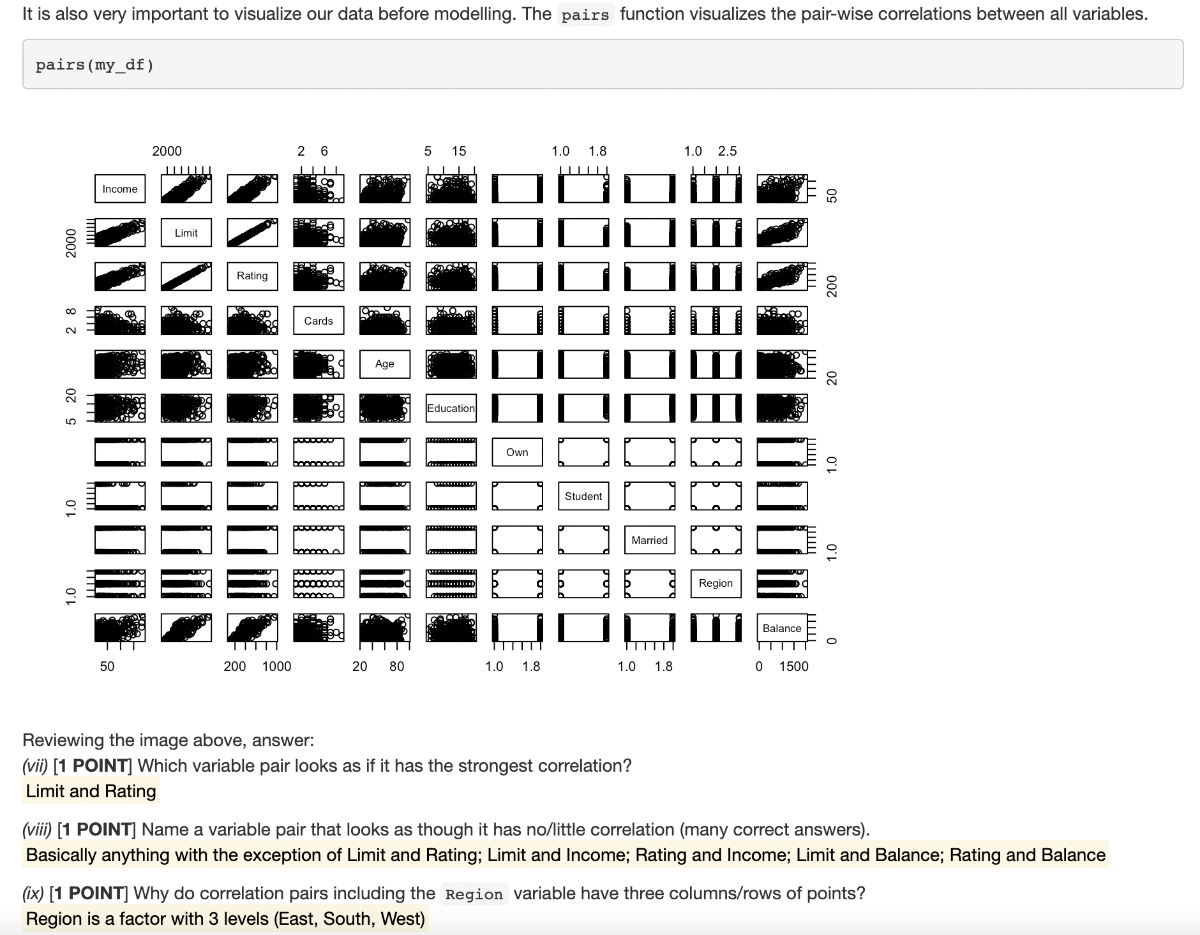

Slide 5
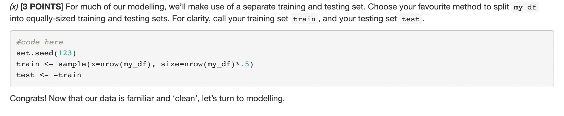
Also acceptable:
createDataPartition() with a p=0.5!
sample(x=nrow(my_df), size = nrow(df)/2)

Slide 6
Question 2
Out of 20

Slide 7
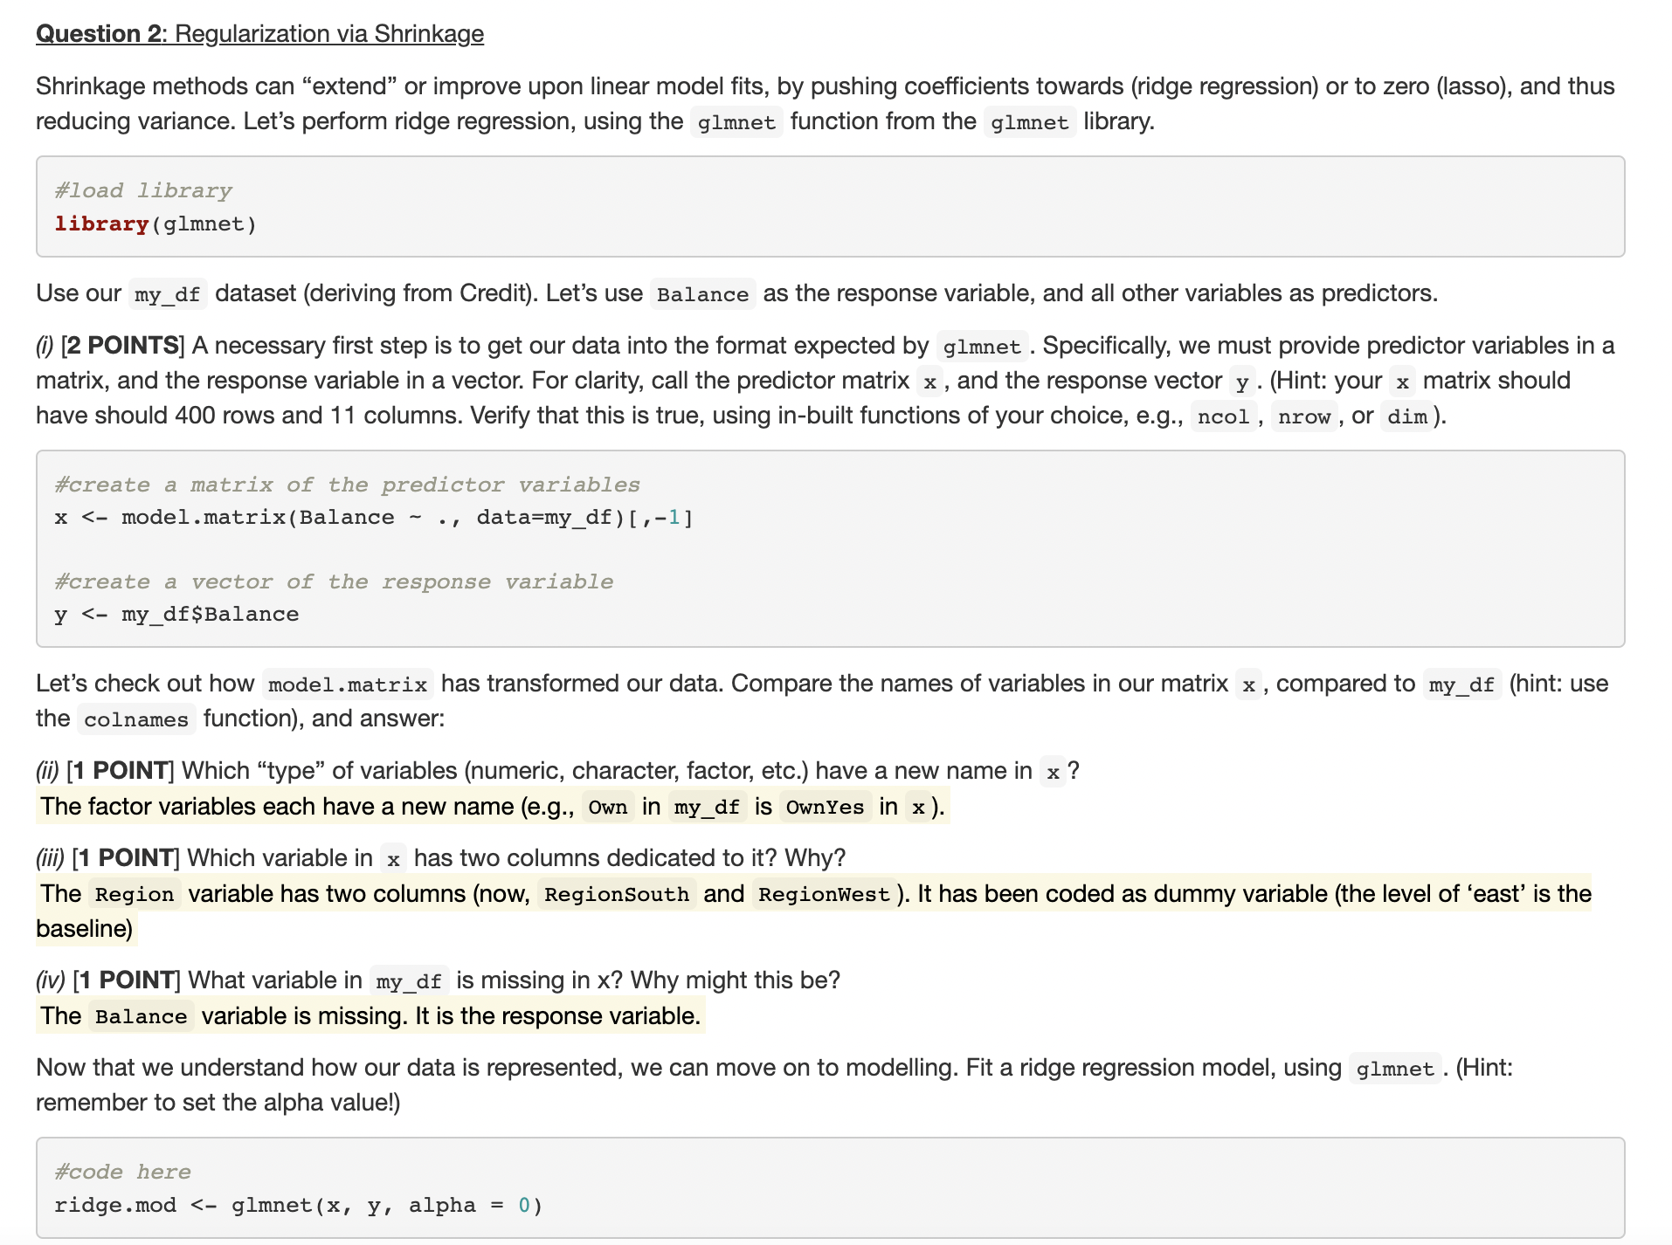
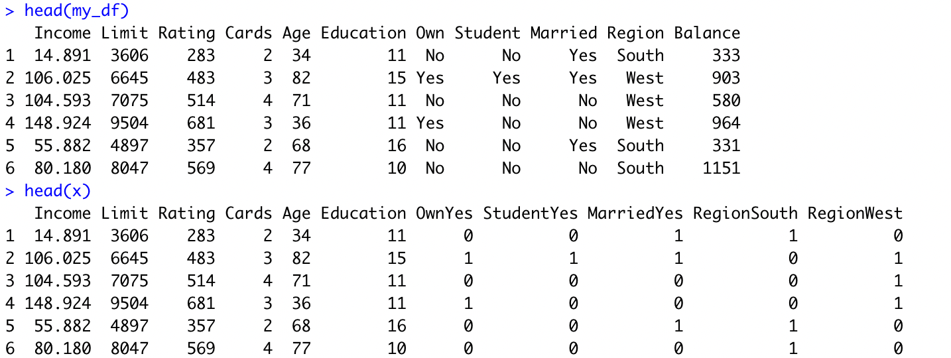
> x <- model.matrix(Balance ~ ., data=my_df)[,-1]
> dim(x)
[1] 400 11

Slide 8
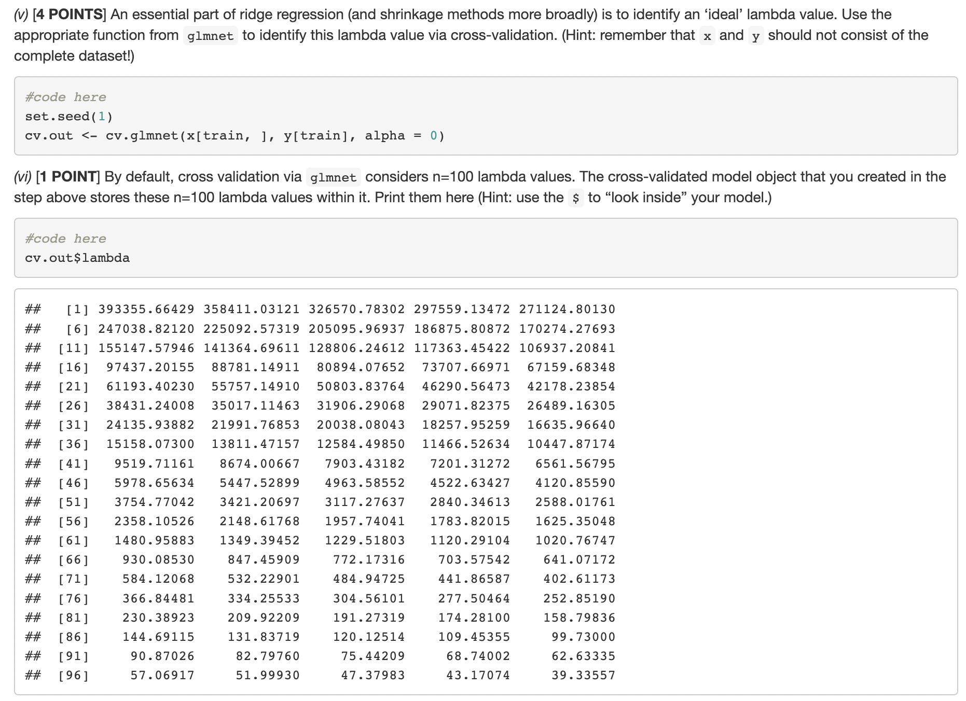
Common error

Slide 9
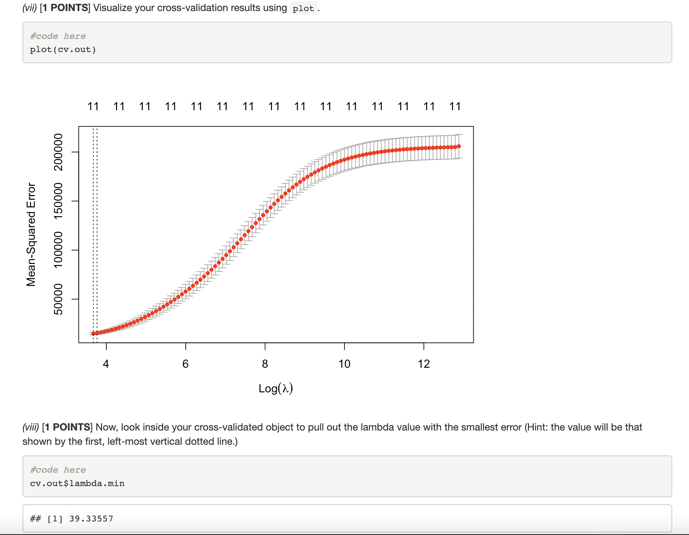
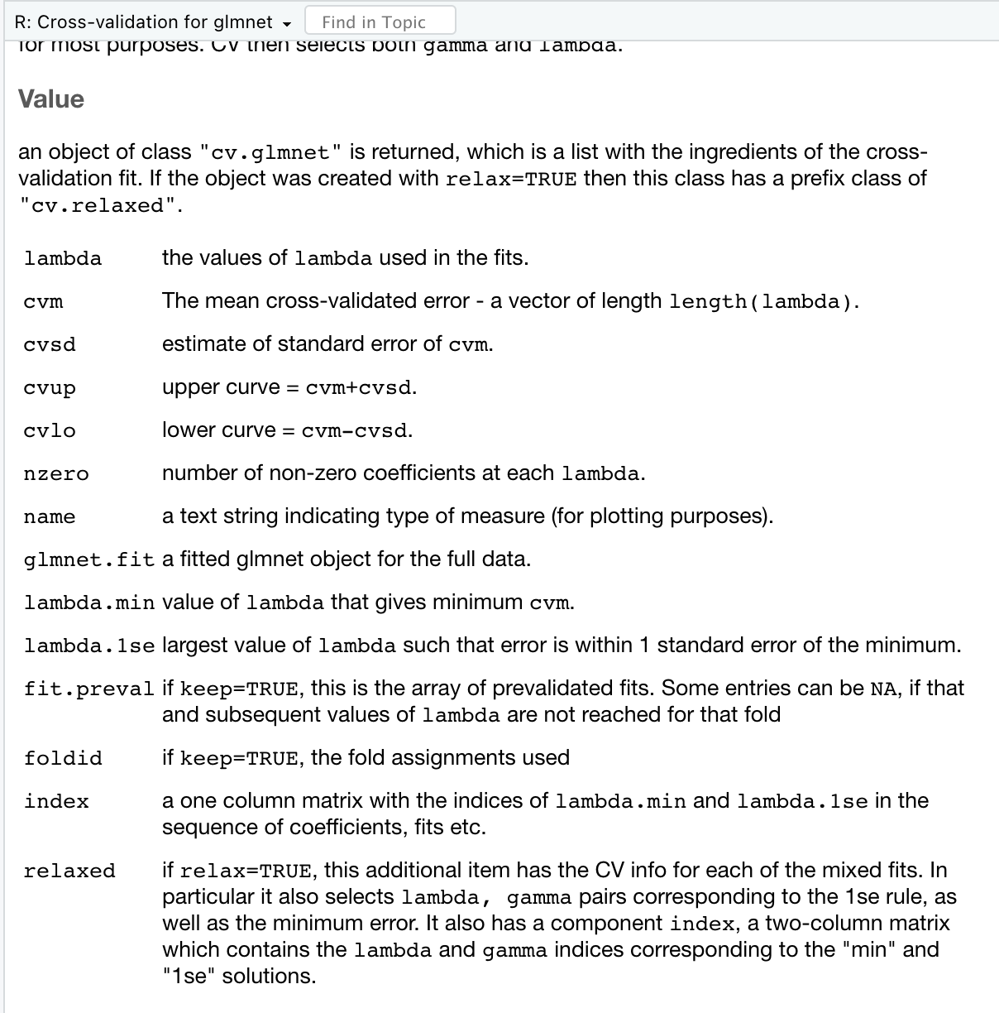
>?cv.glmnet()

Slide 10
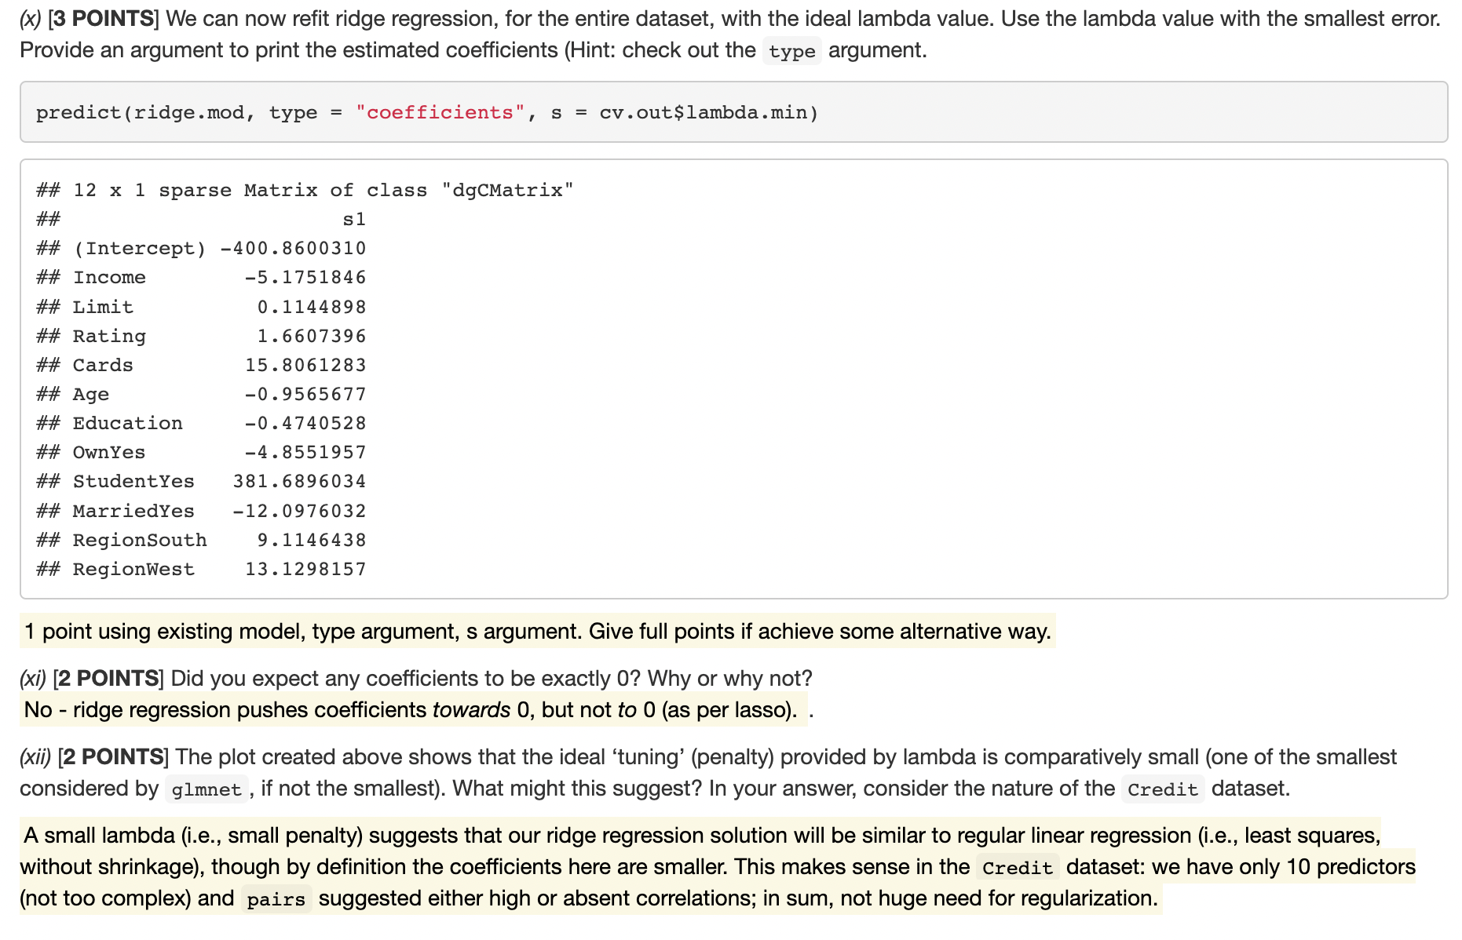
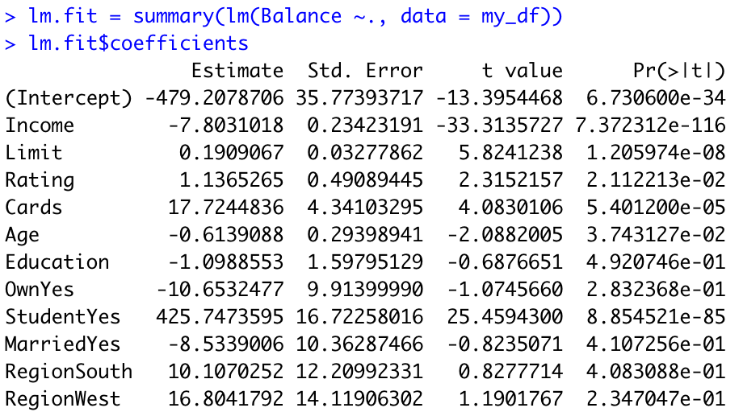
Common error

Slide 11
Question 3
Out of 18

Slide 12
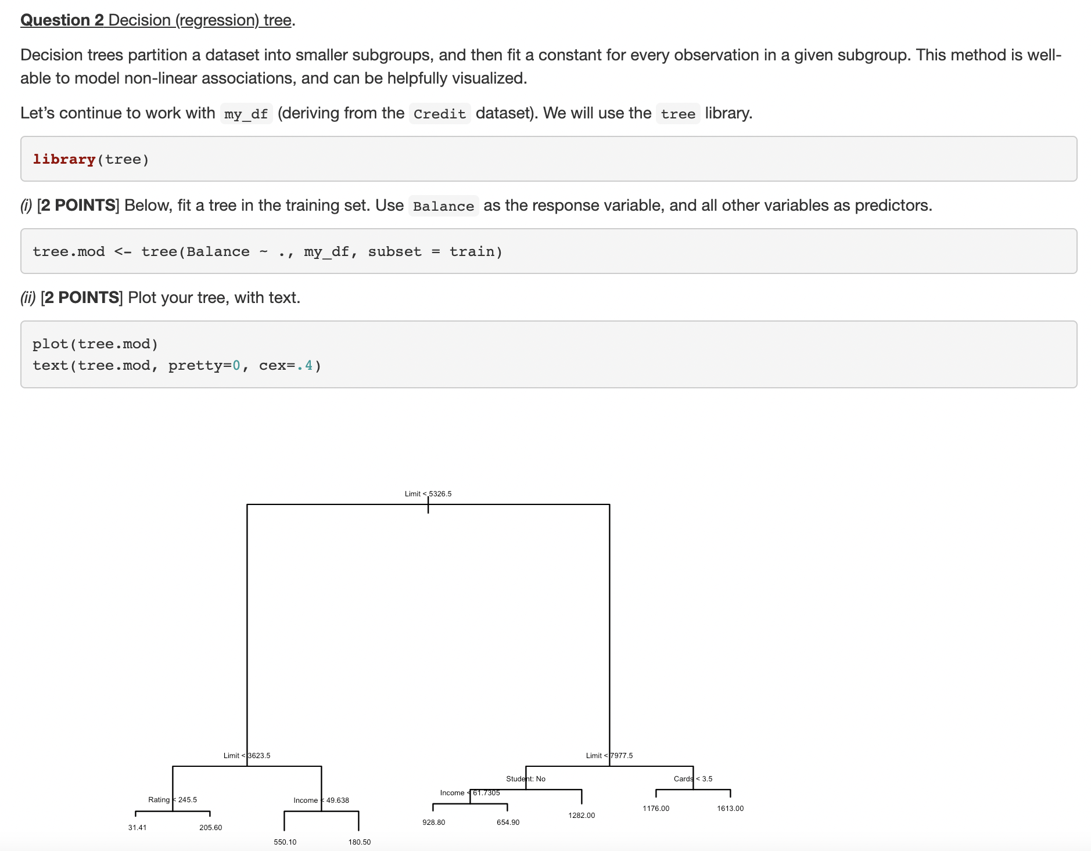
Question 3 Decision (regression) tree

Slide 13
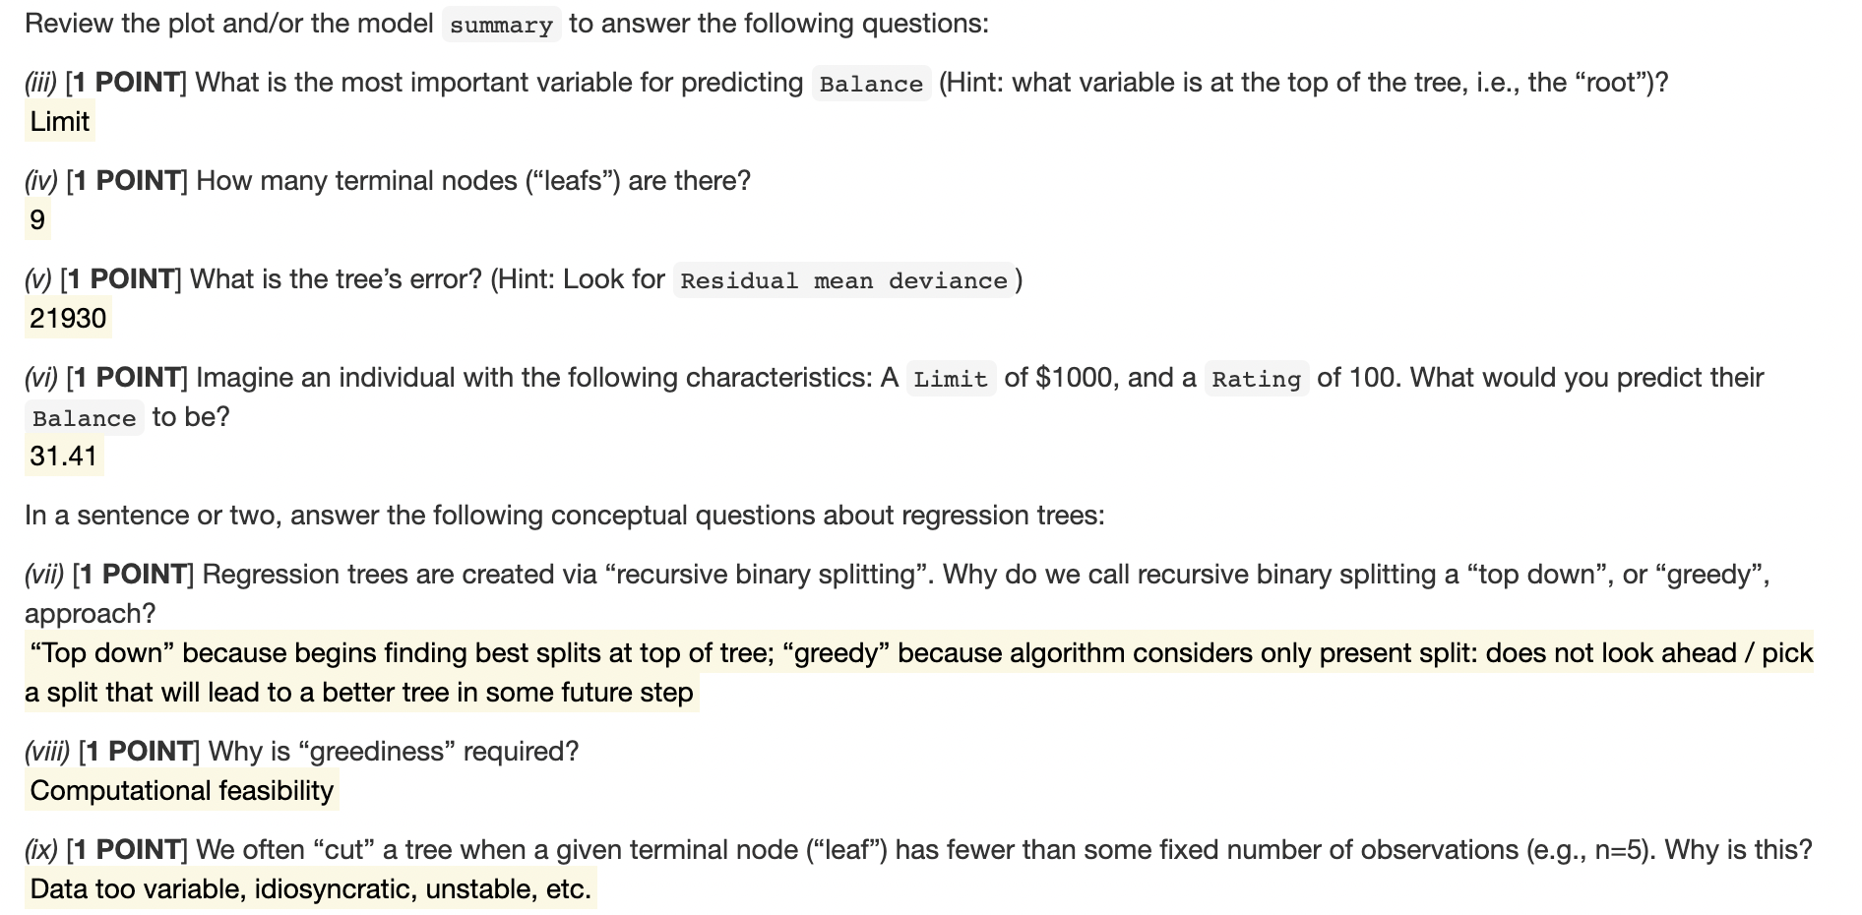
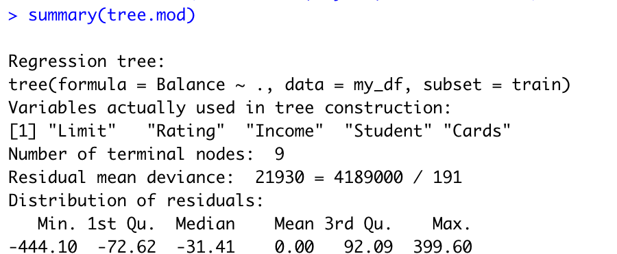
Common error
Limit 1000 <5326.5
Limit 1000 <3623.5
Rating 100 <245.5

Slide 14
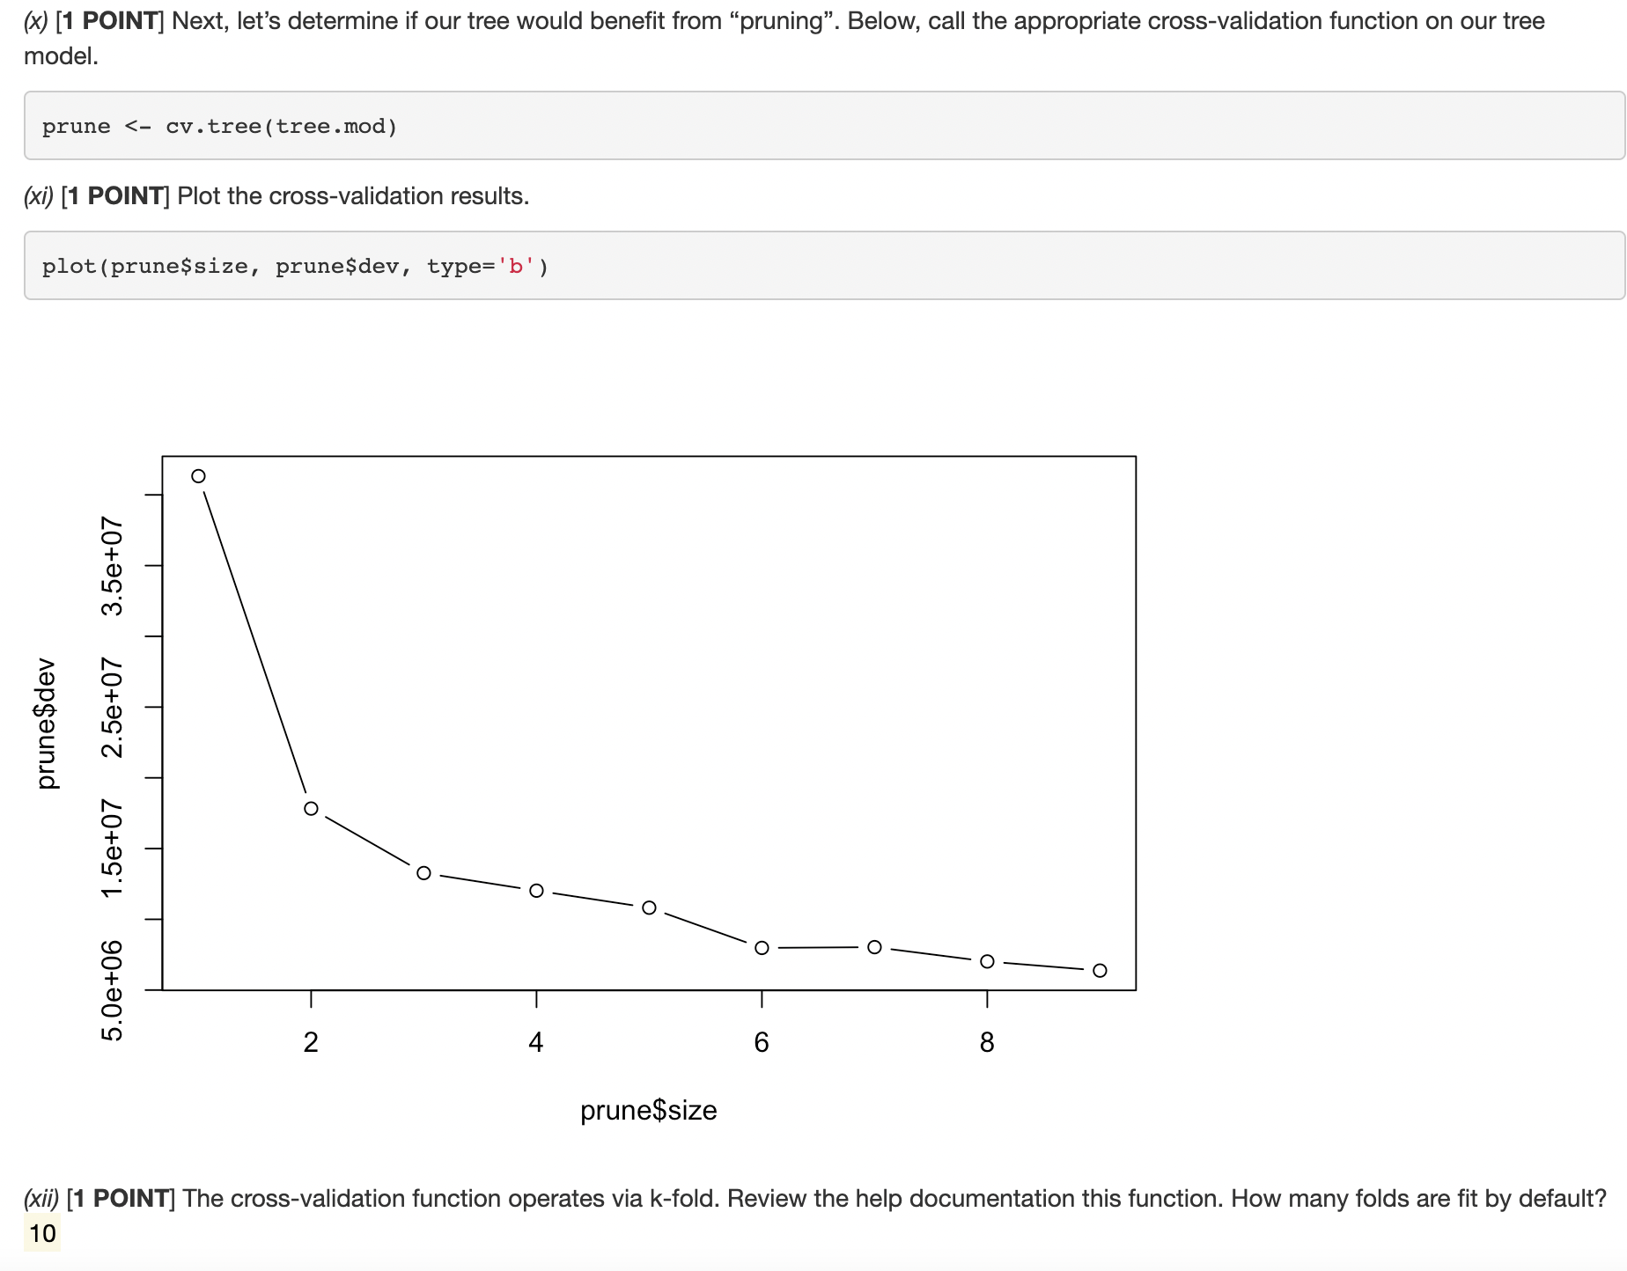
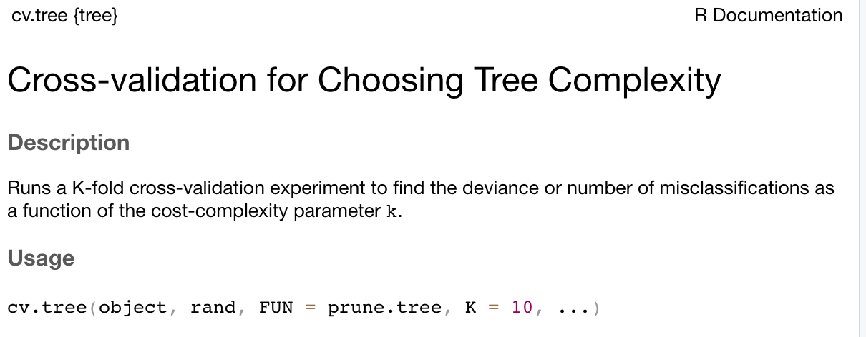
>?cv.tree()

Slide 15
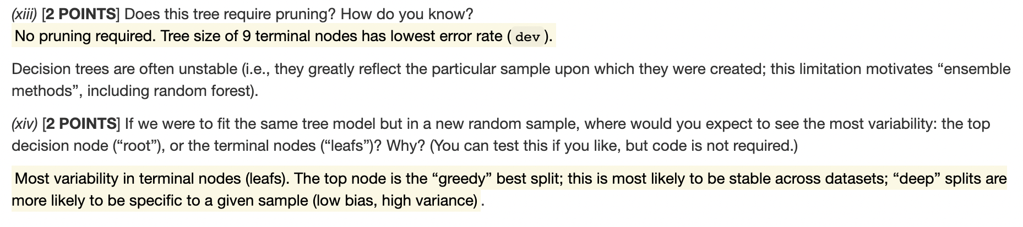
> set.seed(123)
> train <- sample(x=nrow(my_df), size=nrow(my_df)*.5)
> test <- -train
> tree.mod <- tree(Balance ~ ., my_df, subset = train)
> plot(tree.mod)
> text(tree.mod, pretty=0, cex=.7)
> set.seed(1)
> train <- sample(x=nrow(my_df), size=nrow(my_df)*.5)
> test <- -train
> tree.mod <- tree(Balance ~ ., my_df, subset = train)
> plot(tree.mod)
> text(tree.mod, pretty=0, cex=.7)

Slide 16
BONUS
Out of 5

Slide 17
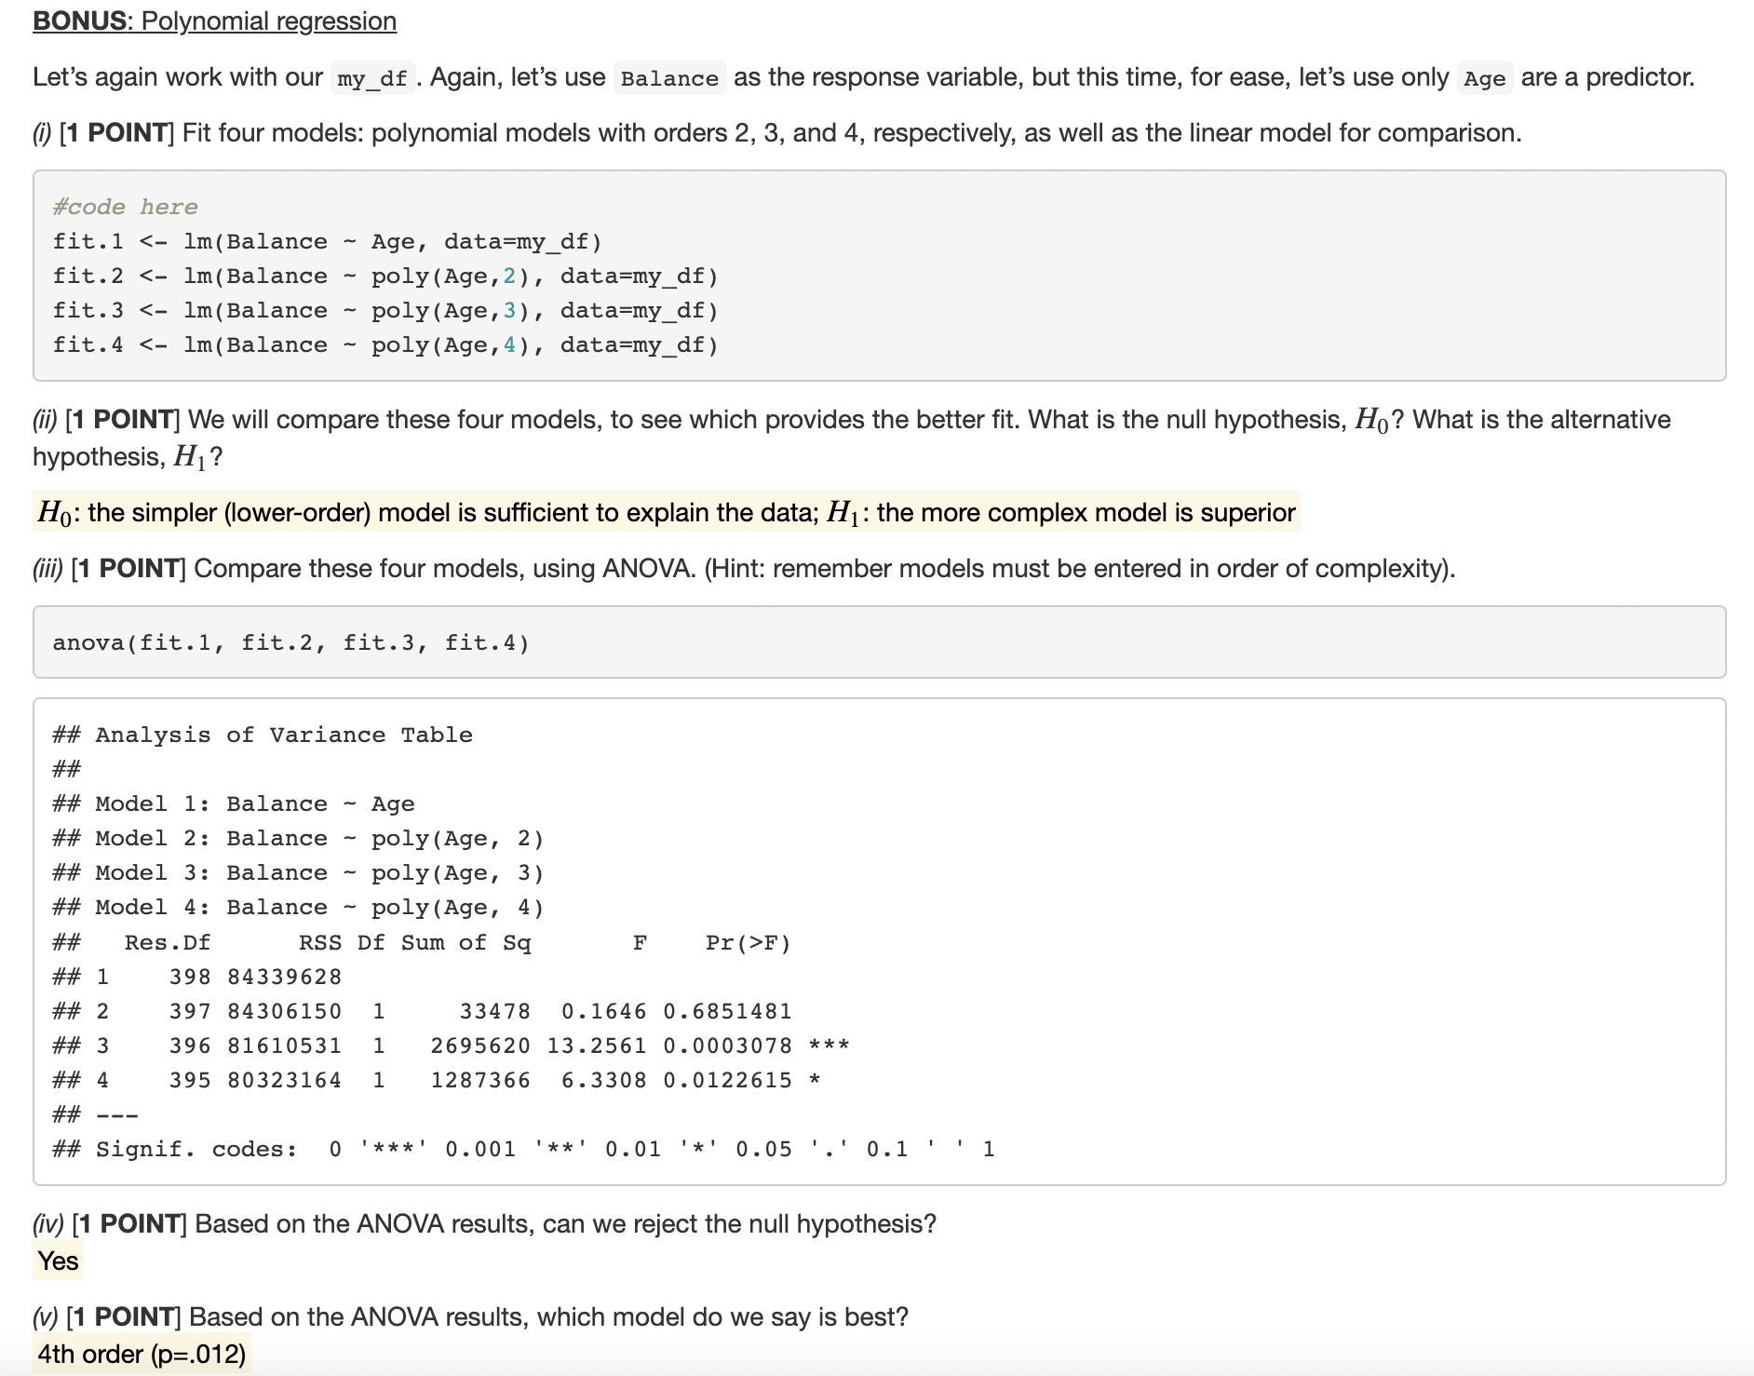
Common error

